Slide 1



Slide 2

3 Different ways
to share your video

Slide 3
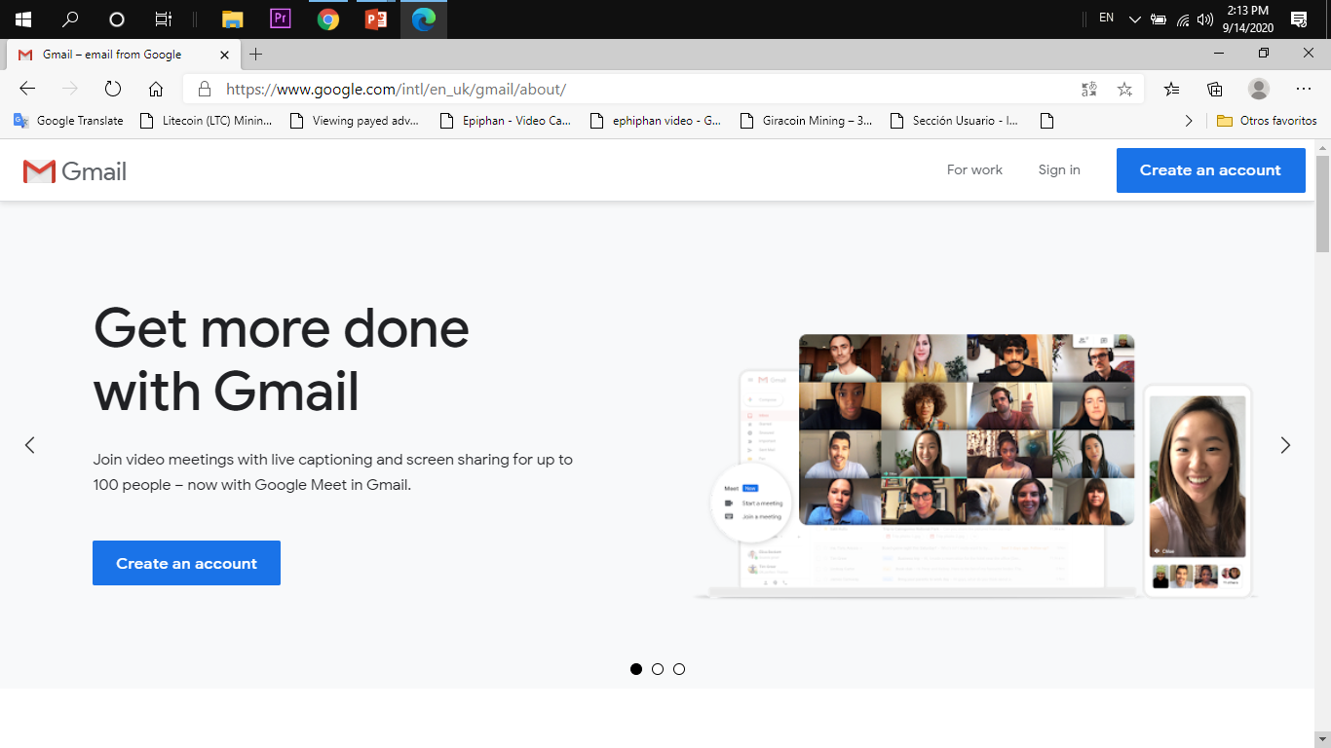

Slide 4
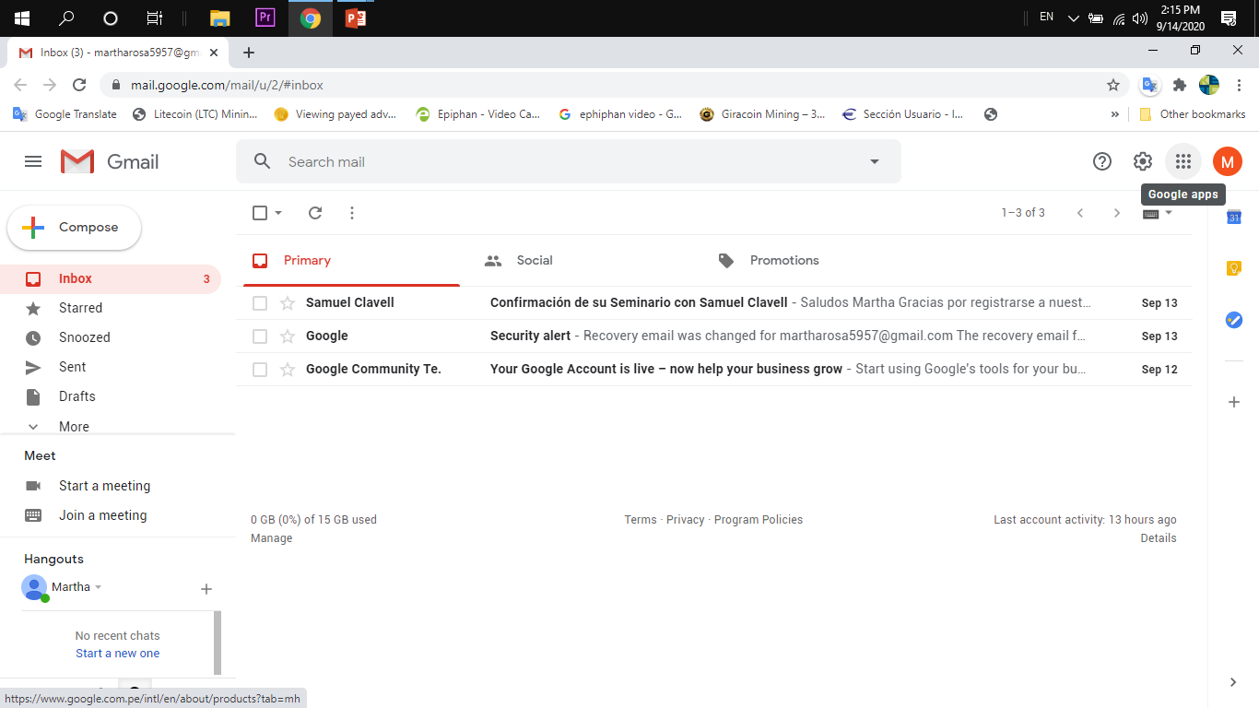

Slide 5
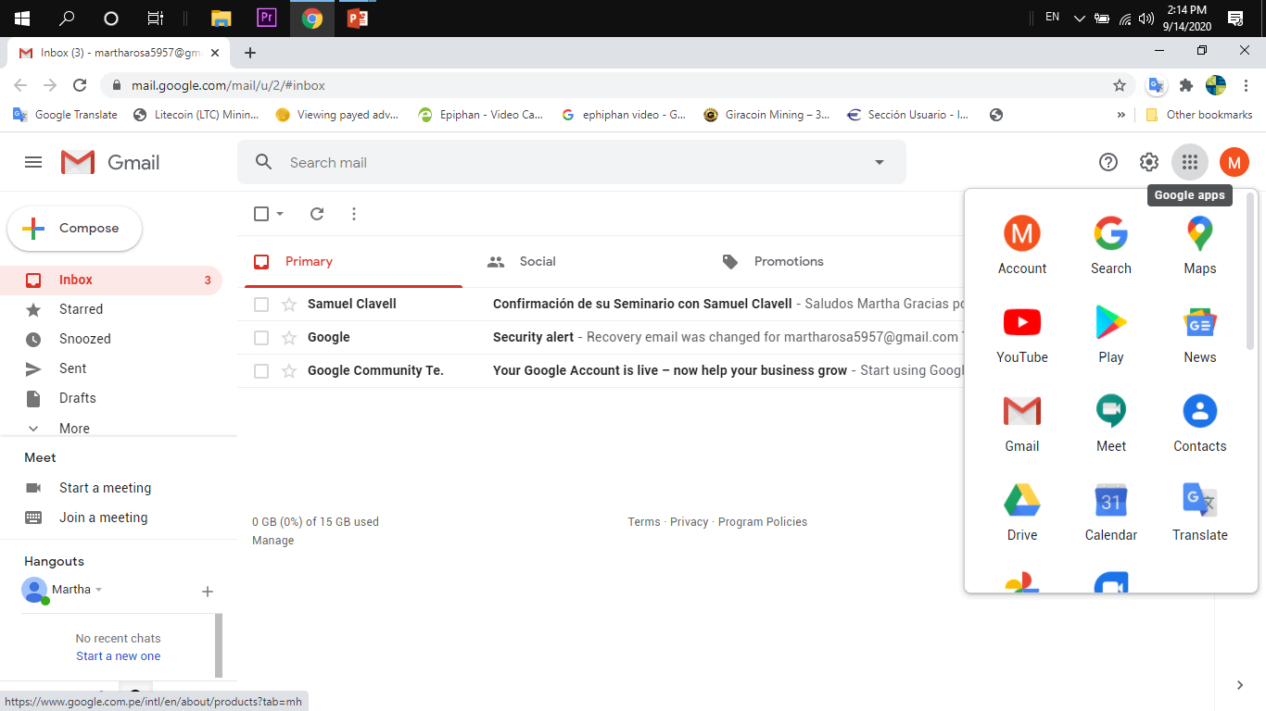

Slide 6
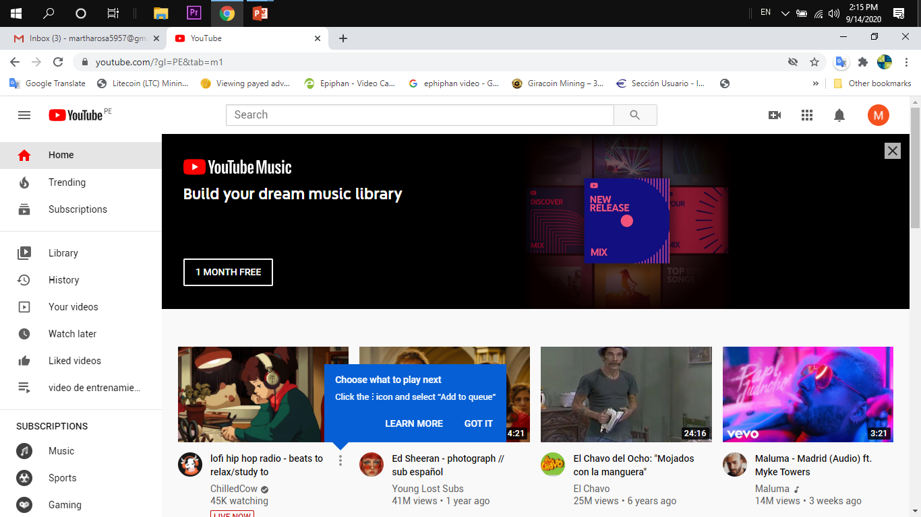

Slide 7
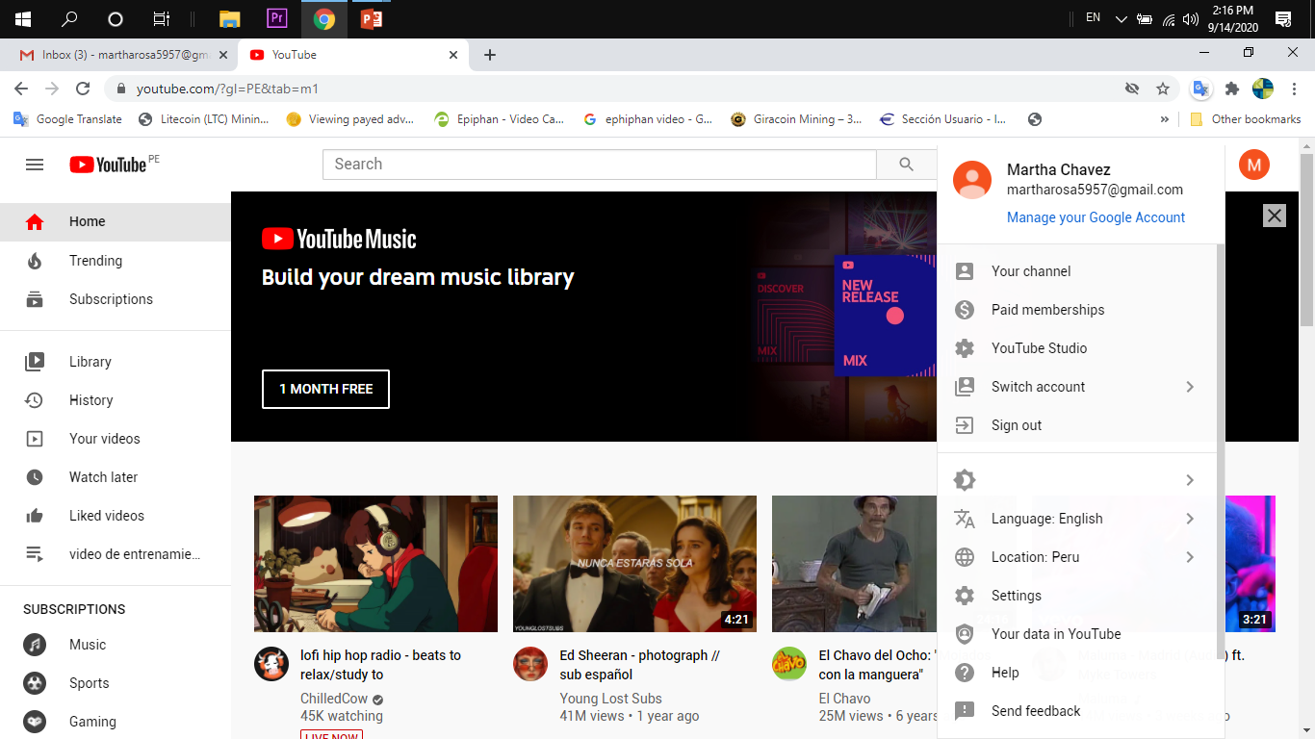

Slide 8
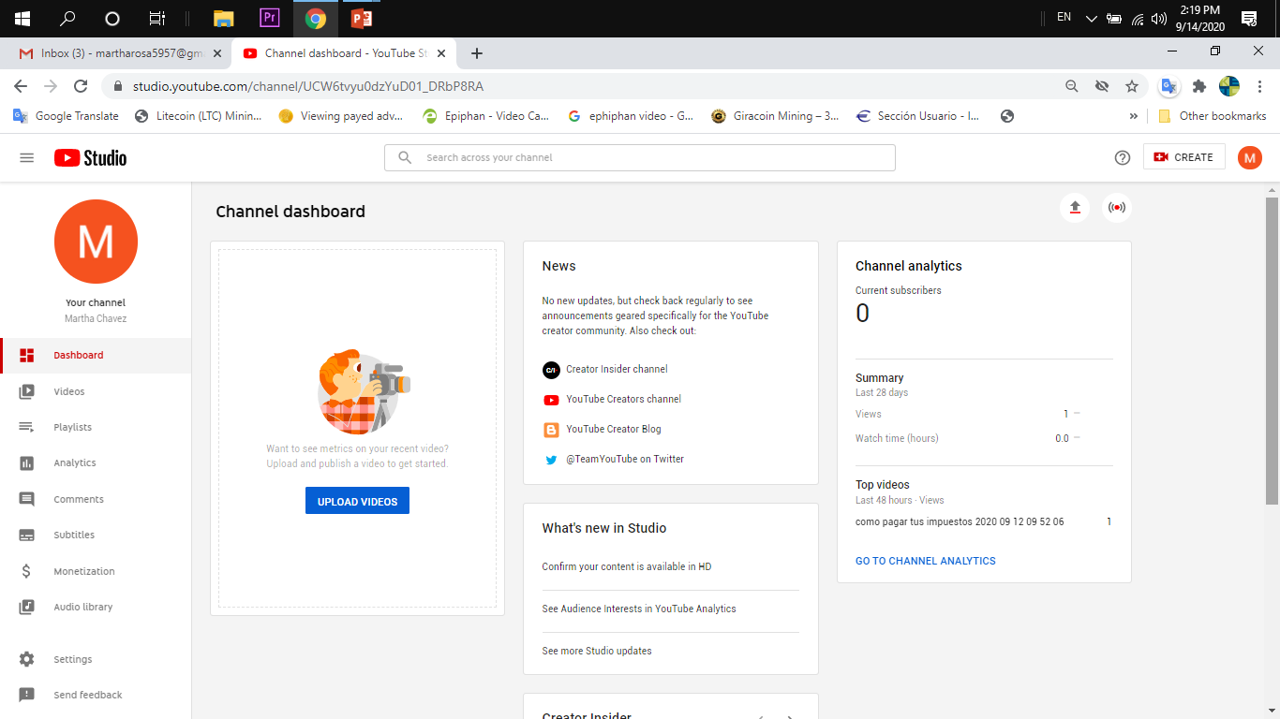

Slide 9

1.- Share your video

Slide 10
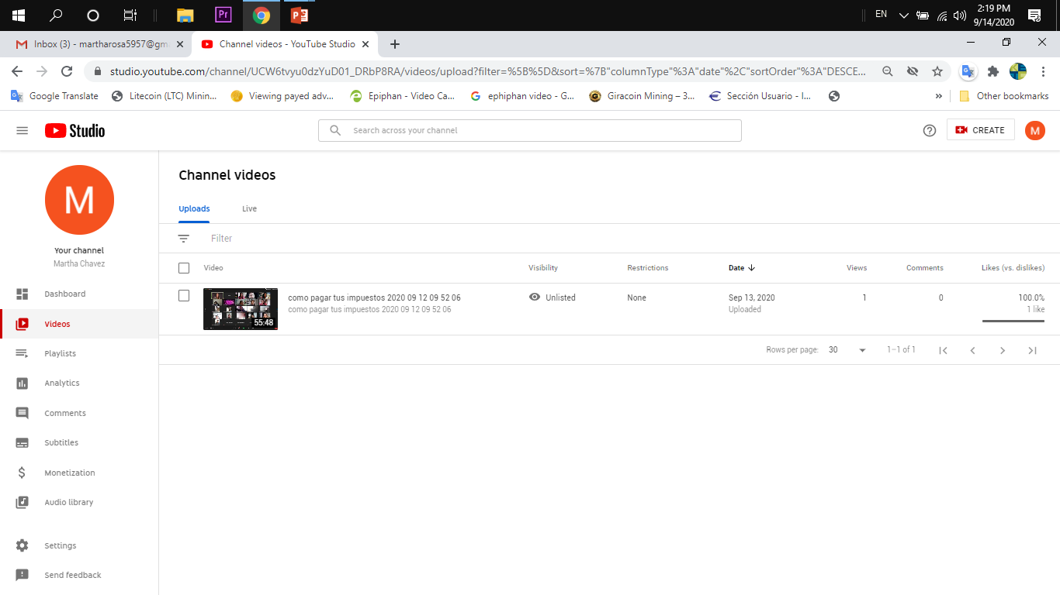

Slide 11
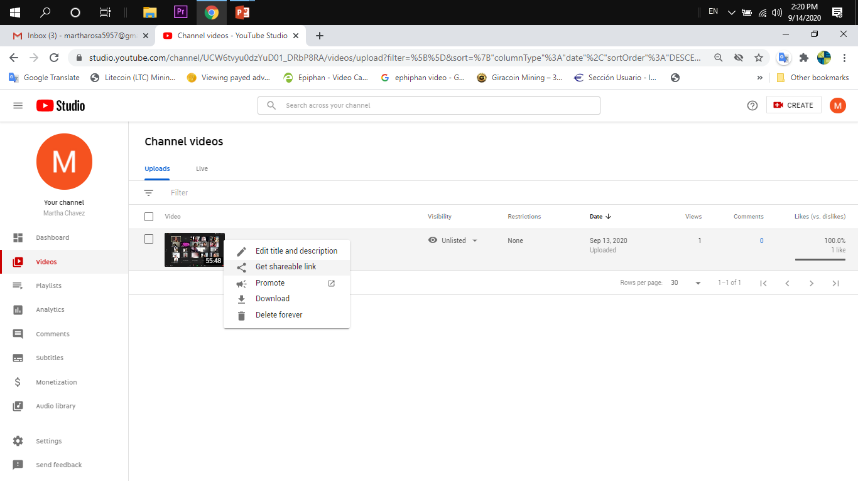

Slide 12
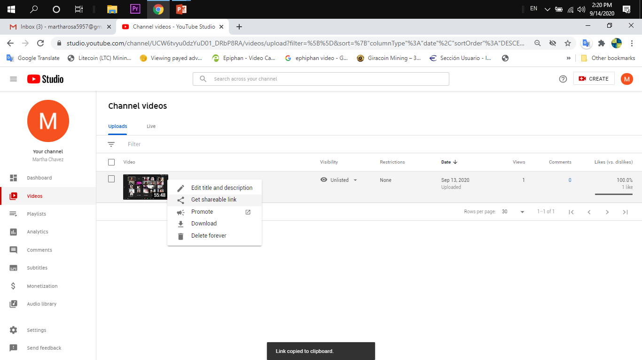

Slide 13
2.- Share your video

Slide 14
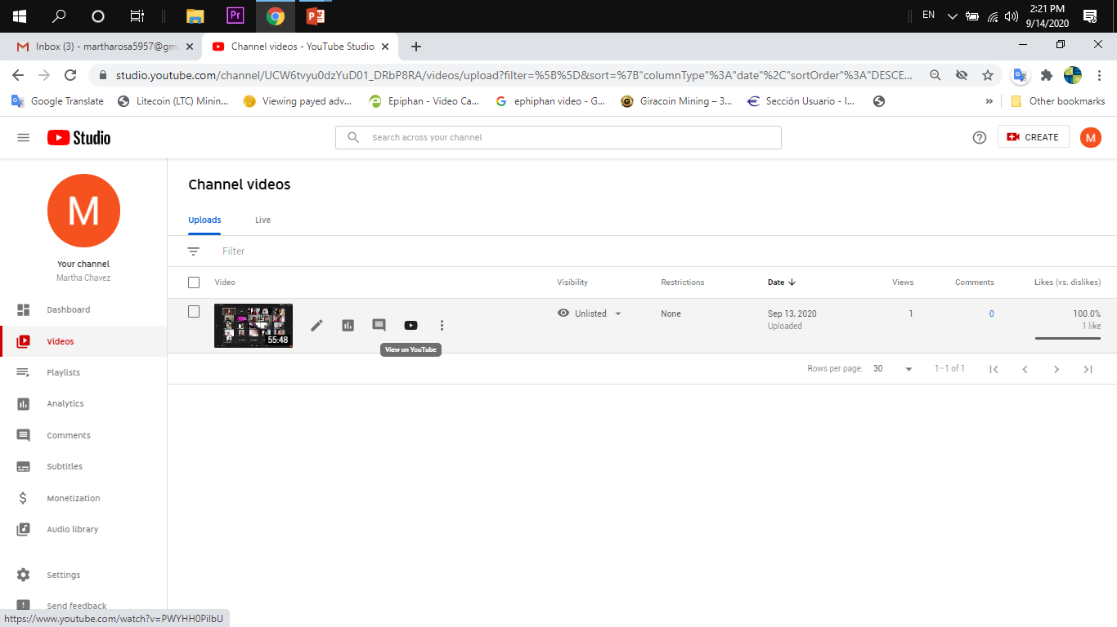

Slide 15
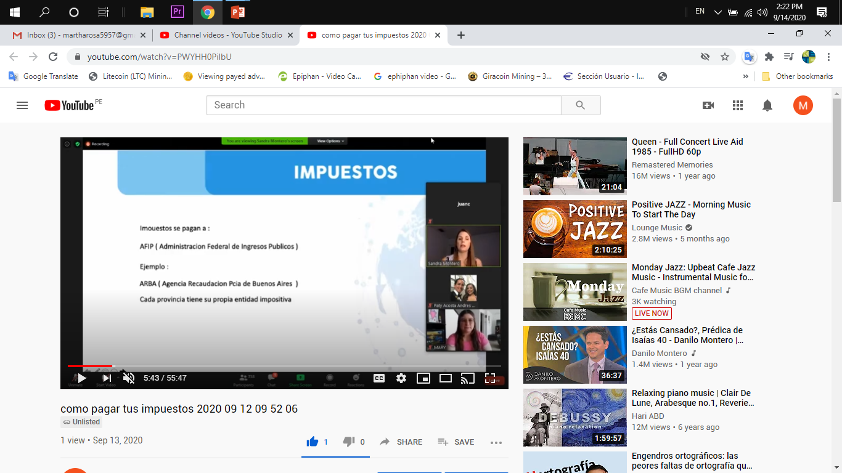

Slide 16
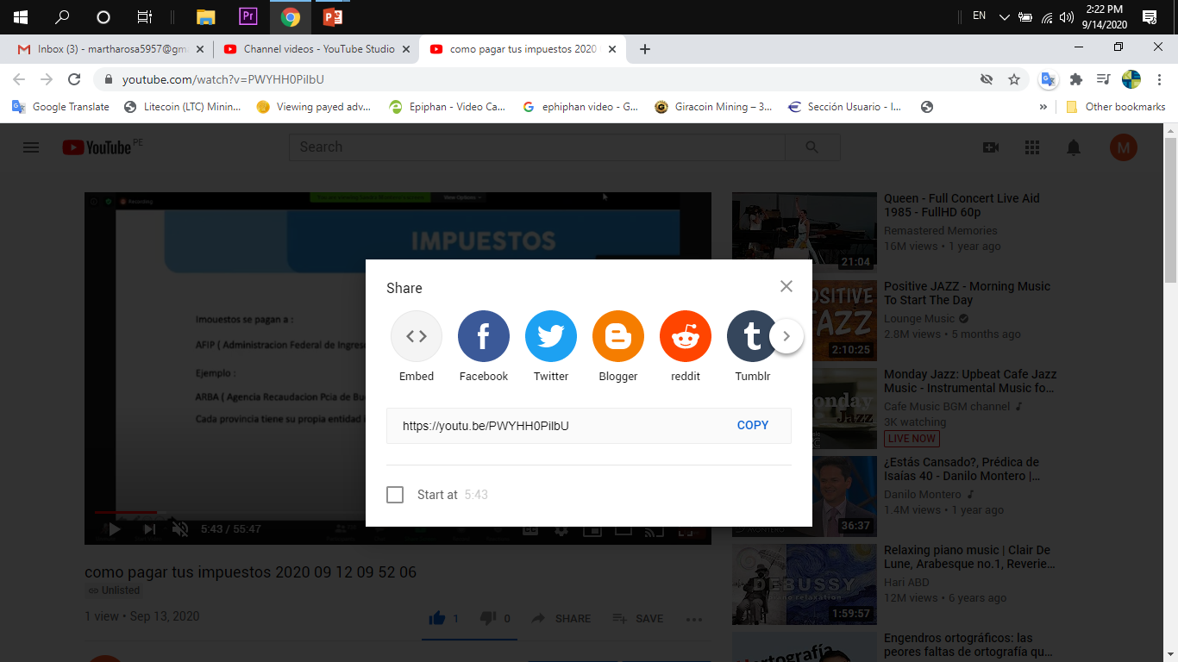

Slide 17
3.- Share your video

Slide 18
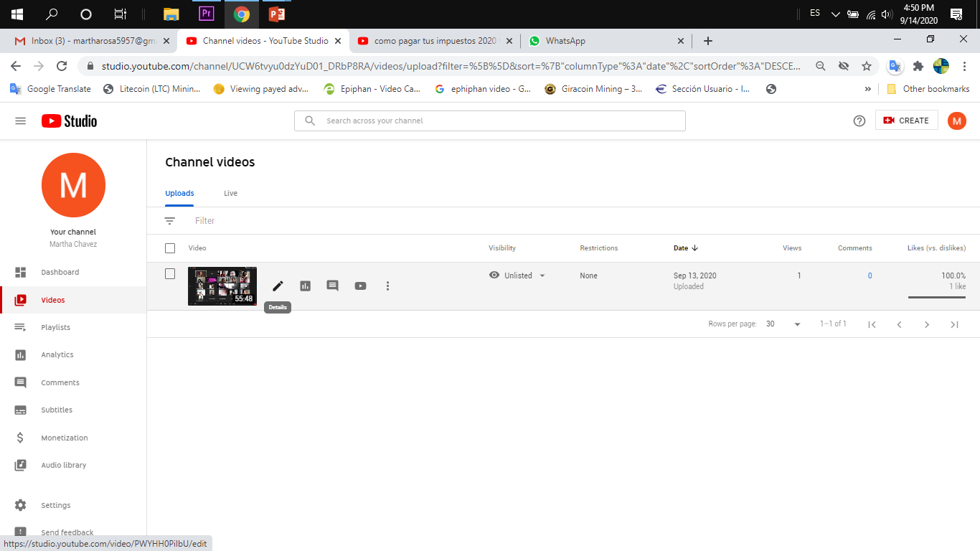

Slide 19
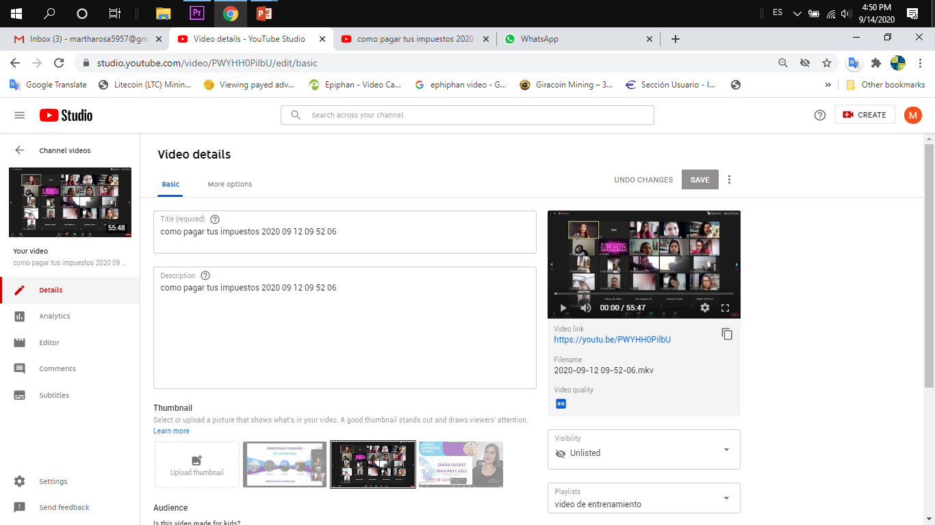

Slide 20
Carlos Analco
unnegociolocal@gmail.com
Whatsapp Business
+51-977-411-688
www.unnegociolocal.com
#tools2share

